Slide 1
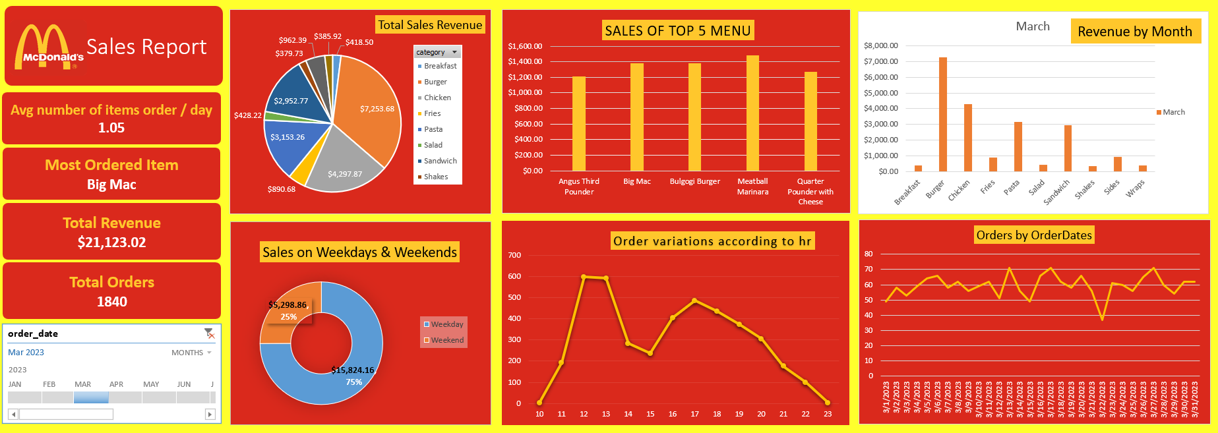

Slide 2
Summary of above dashboard
This dashboard provides an overview of McDonald's sales performance for March 2023. It includes key metrics, visualizations, and insights into sales trends, revenue distribution, and order patterns.
Key Metrics
Average Items Ordered per Day: 1.05 items/day
Most Ordered Item: Big Mac
Total Revenue: $21,123.02
Total Orders: 1,840 orders

Slide 3
Key Insights
1. Revenue Breakdown
Top Revenue-Generating Category :
Burgers contribute the highest revenue of $7,253.68, followed by Chicken ($4,297.87) and Breakfast ($3,153.26).
Top 5 Menu Items by Sales:
Big Mac is the most popular item, generating significant revenue.
Other top items include:
Bulgogi Burger
Meatball Marinara
Quarter Pounder with Cheese
Angus Third Pounder
2. Revenue by Month
In March, Burgers dominate revenue contributions compared to other categories such as Fries, Chicken, and Sandwiches.
3. Weekday vs Weekend Sales
Weekday Sales account for 75% of total revenue ($15,824.16), indicating a higher customer turnout during the workweek.
Weekend Sales account for 25% ($5,298.86).
4. Hourly Order Variations
Peak ordering hours are around 1 PM (lunch) and 7 PM (dinner), with the highest activity recorded at 1 PM.
Orders gradually decline after 8 PM, reaching their lowest point late at night (10 PM to midnight).

Slide 4
Actionable Recommendations
Focus on High-Performing Items:
Promote Big Mac and other top 5 menu items through deals and combos.
Target Peak Hours:
Enhance staffing and operational efficiency during peak hours (1 PM and 7 PM).
Boost Weekend Sales:
Run promotions or discounts to attract more weekend customers.
Diversify Revenue Streams:
Focus on underperforming categories like Pasta and Wraps to increase their contribution.
Continue Leveraging Weekday Momentum:
Consider launching loyalty programs targeting weekday customers to maintain high revenue.

